Slide 1


Slide 2
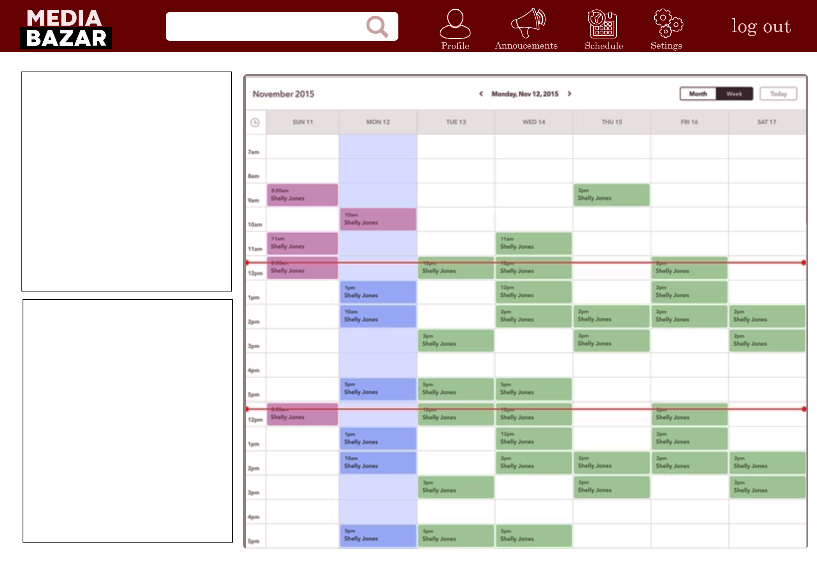

Slide 3
https://xd.adobe.com/view/63f1bf0a-430c-4ad4-761a-52c3852c2cb0-15c0/
Wireframe

